Slide 1
IOT-CLOUD SOLUTION ARCHITECTURE FOR CHARITE BeST
INTRODUCTION TO CLOUD COMPUTING (BST-BCS-20A), SRH UNIVERSITY BERLIN, Prof Dr TAMM GERRIT
Matei Baciu
Ryan Sim
Meirah Alsereidi
Mariam Ahmed
Liepa Kremeryte
Omar Abdelaziz

Slide 2

Project Overview: impact of AI on the world- of healthcare
AI and IoT revolutionize hospitals, enabling faster diagnoses, early disease detection, and real-time patient monitoring (e.g., smart beds tracking vitals).
AI ensures hospitals stay stocked by tracking equipment and medication usage.
Simulation environments and training tools powered by AI improve medical education.
Microsoft Azure drives this digital transformation, making efficient, cost-saving, and better patient care a reality.
Hospitals Before

Slide 3

Hospitals After

Slide 4

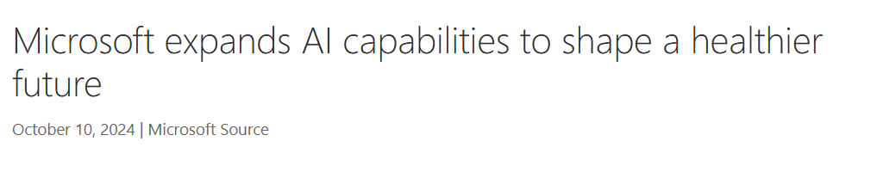
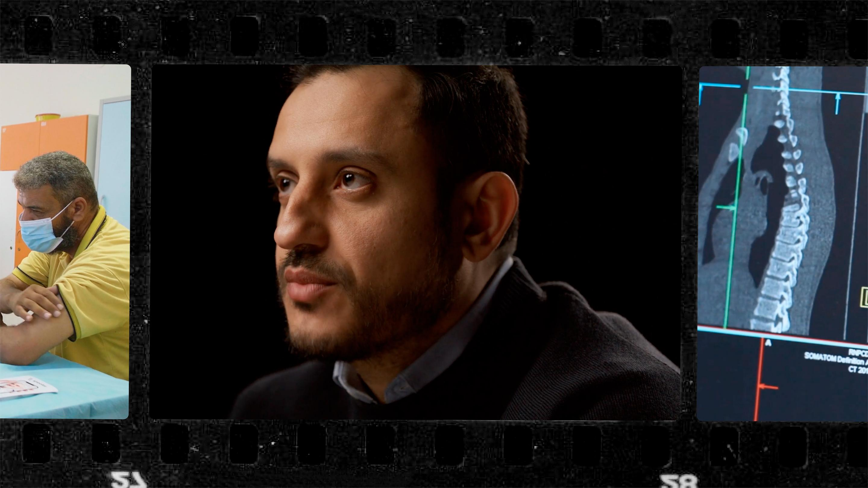

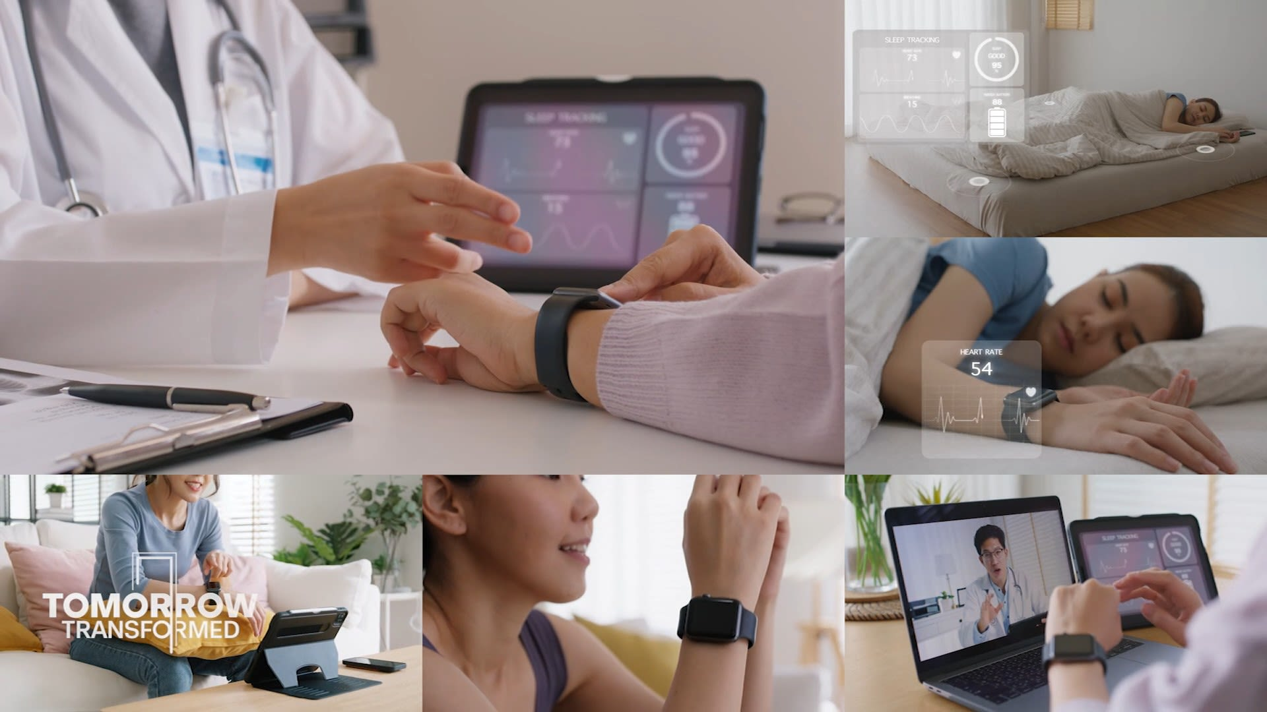
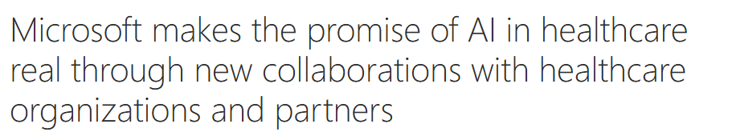
Current Trends and News
Sources: http://bit.ly/3BxAePB https://tinyurl.com/mr2wthap https://tinyurl.com/y4mxe6yr https://tinyurl.com/5bakktcb https://tinyurl.com/2u3wv993 https://tinyurl.com/wryukhhs

Slide 5

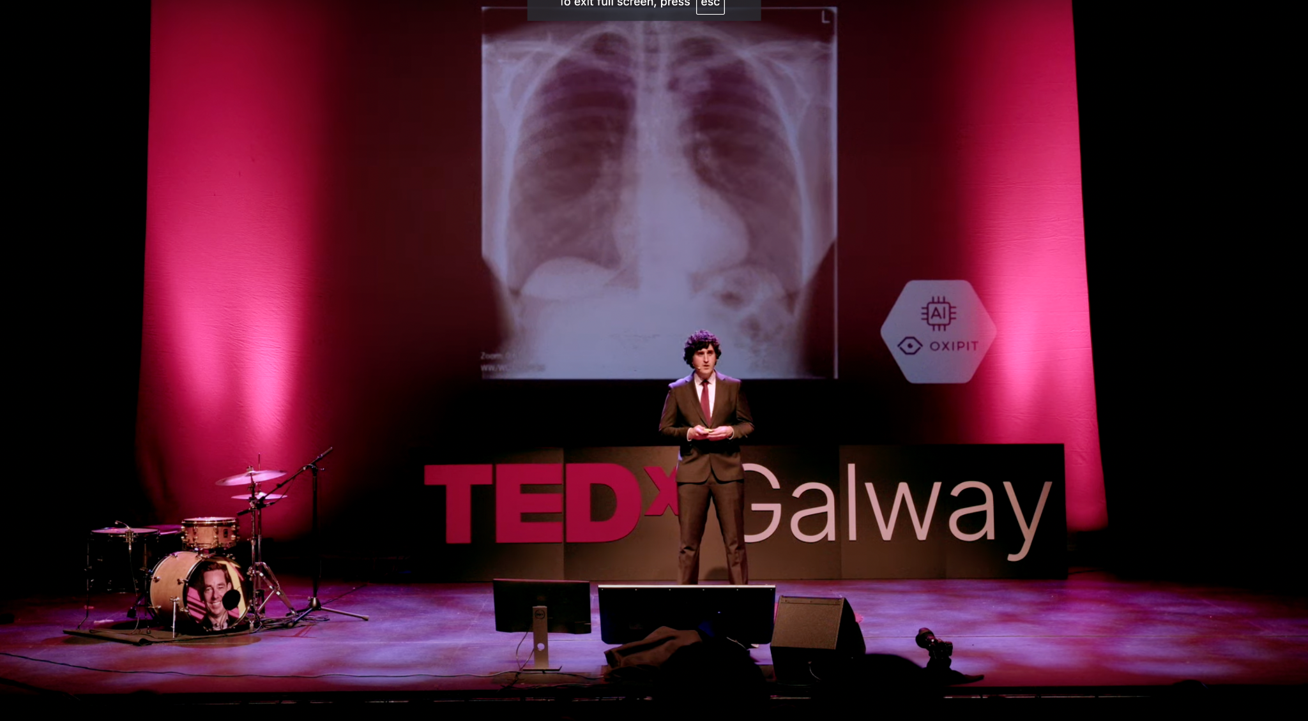


https://tinyurl.com/yencf85d
https://tinyurl.com/28m62655
https://tinyurl.com/mr2e2mhr

Slide 6
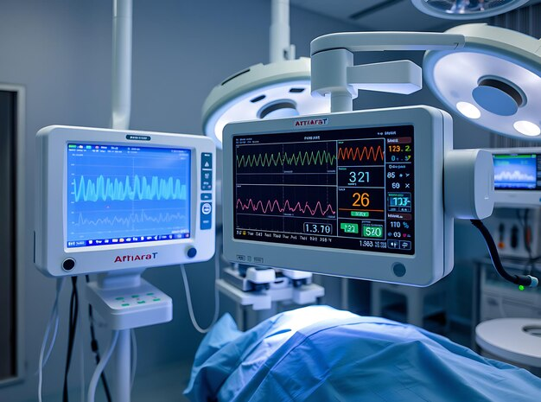
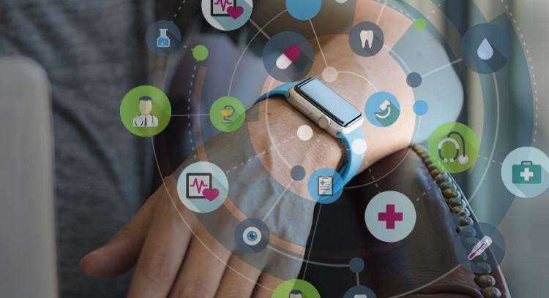
Why IoT-Cloud Solutions Matter in Healthcare
2020: Edge Computing Arrives
Faster decisions with local data processing.
Tools: Azure IoT Hub, AWS Greengrass, GCP AI.
2021: Clear Impact
Smarter care with cloud solutions.
Highlights: Azure Health Bot, AWS storage, GCP analytics.
Used in German hospitals for records and inquiries.
2022: COVID-19 Response & Better Training
Remote monitoring, AI virus predictions, secure data management.
Safe, data-driven simulations for healthcare workers.
Future Vision
Faster, personalized, proactive, and accessible healthcare.
https://shorturl.at/AQcii
https://shorturl.at/KOygX
https://shorturl.at/2wG4U

Slide 7

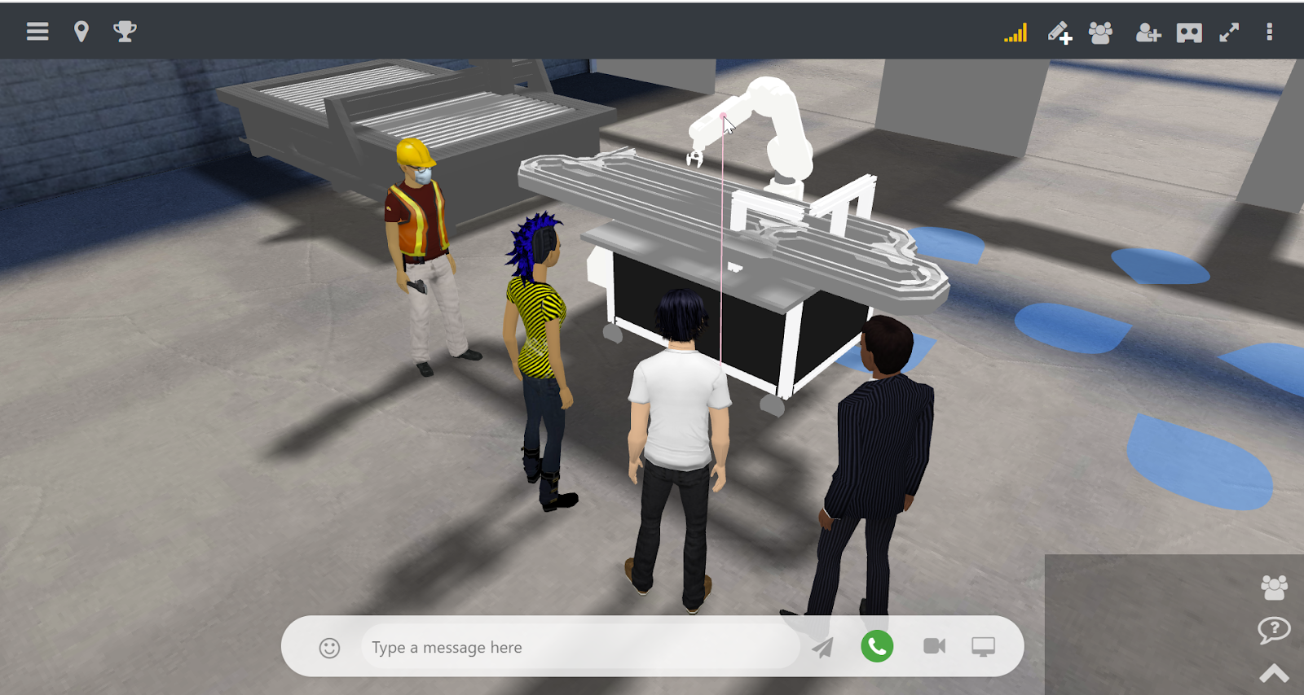
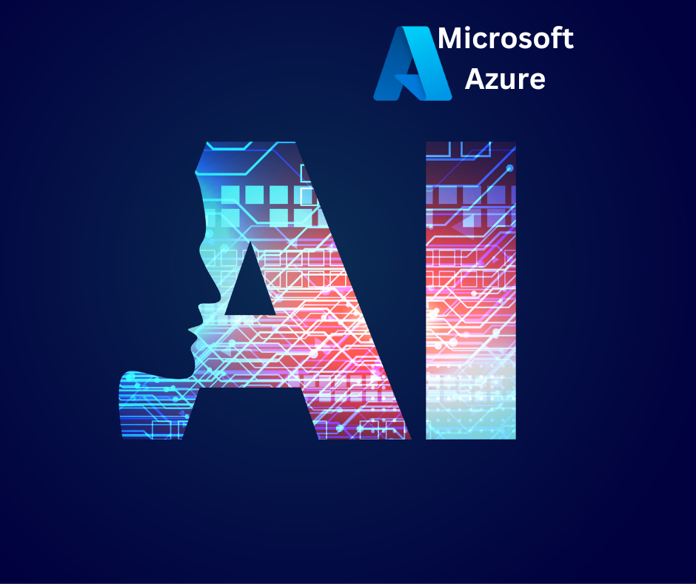
Education sector: Applications in simulation and Training Centers
Immersive Training: (E.g. Use Azure Digital Twins and HoloLens)
Azure uses VR/AR simulations for medical training, allowing practice of procedures and interaction with 3D anatomy models.
AI-Enhanced Feedback: Adaptive training insights using Azure AI and IoT integrations.
Azure AI personalizes training and provides real-time feedback to improve skills and decision-making based on different performances.
IoT in Training Centers: Connected devices for monitoring and feedback.
Azure connects devices and sensors to monitor trainee performance in real-time, tracking techniques like CPR or surgery. Biofeedback sensors capture physiological responses, such as stress or heart rate, to prepare for high-pressure situations.
Cloud-Based Scalability: Enable virtual labs and global learning accessibility.
Azure enables cloud-based labs for remote access to training resources and real-time collaboration through Microsoft Teams during simulations and case studies.
https://tinyurl.com/mv8u684f: https://tinyurl.com/365puvkw
https://tinyurl.com/yjemchnk https://tinyurl.com/2byff84r
https://tinyurl.com/28fd7nru https://tinyurl.com/5t5a5y26
https://tinyurl.com/szzjupxe https://tinyurl.com/46v5rhj4

Slide 8
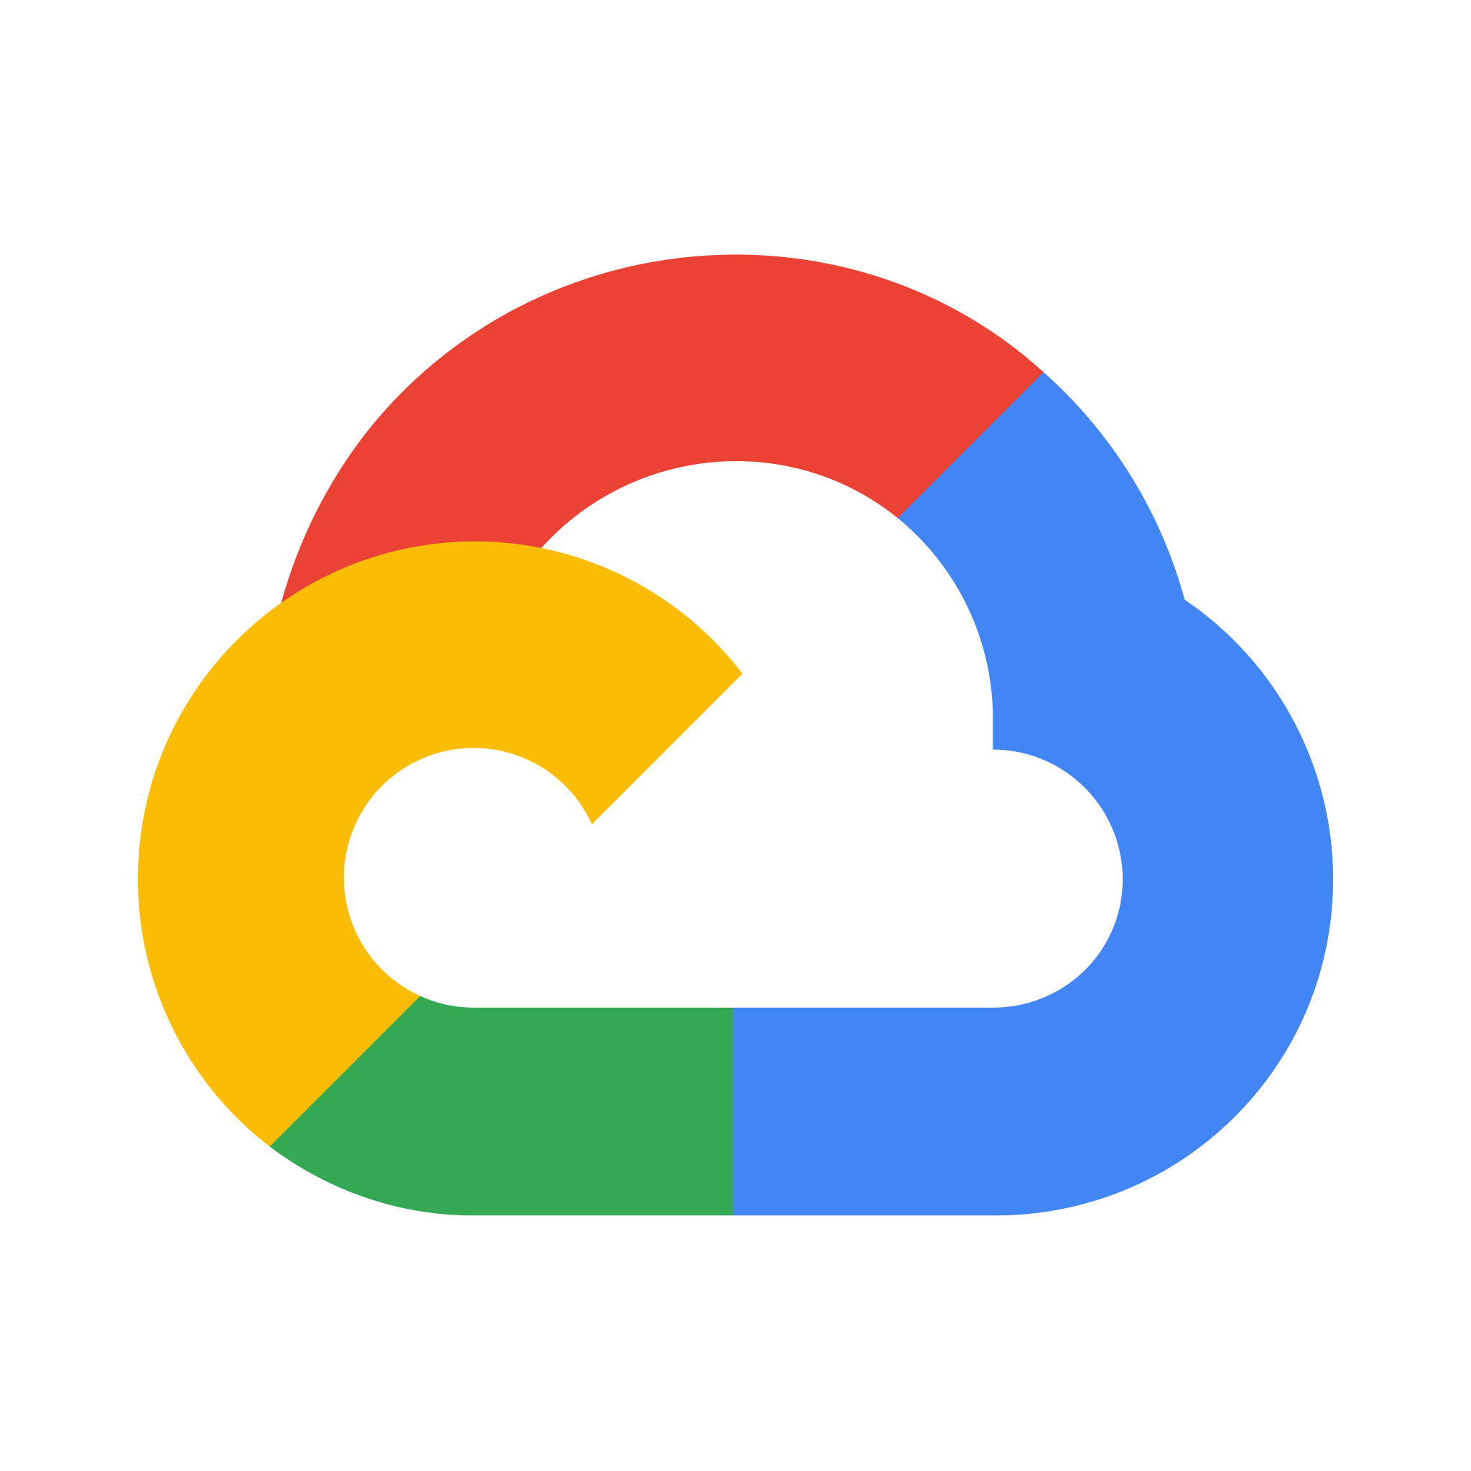

Comparative analysis of cloud providers
Cloud Providers in Healthcare
Amazon Web Services (AWS): Offers AWS HealthLake for storing, transforming, and analyzing health data. Excels in scalability and extensive service variety
Google Cloud Platform (GCP):
Specializes in Big Data analytics and AI. The Healthcare API ensures interoperability across EHR systems, enabling seamless data exchange​
Microsoft Azure:
Provides Azure Health Data Services for GDPR-compliant solutions. Integration with tools like FHIR, Synapse, and IoT enhances healthcare data analysis and security​
https://tinyurl.com/3manp9n4

Slide 9

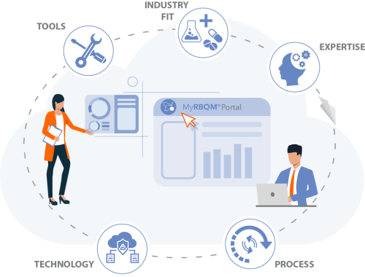
MS Azure & Customer Stories
Cyntegrity:
Develops the MyRBQM® Portal, a SaaS platform on Azure that manages clinical trial risks by harmonizing data, enabling risk-based quality management (RBQM), and predictive analytics.
https://tinyurl.com/5n7vd32s

Slide 10
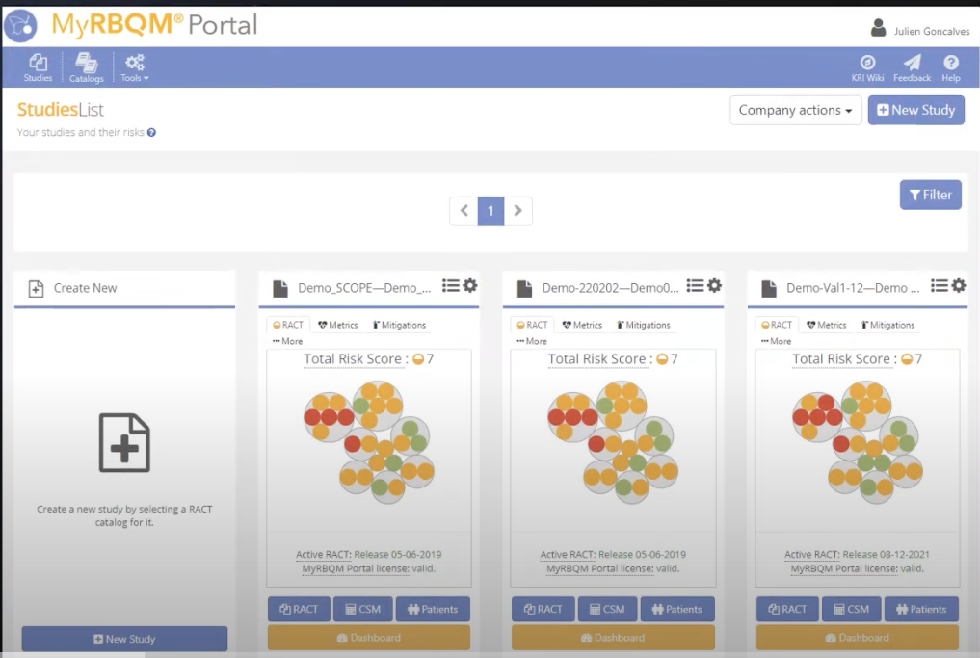

Slide 11


MS Azure & Customer Stories
Kinderhaus AtemReich:
Implements AI-driven processes with Azure Machine Learning and Teams, ensuring quality respiratory care despite staffing constraints
https://tinyurl.com/yck3wvbd
Notes:
Cyntegrity is revolutionizing the way clinical trials are managed with their MyRBQM® Portal, a SaaS solution built on Microsoft Azure. This platform harmonizes data across clinical trials, enabling advanced risk-based quality management, or RBQM, and predictive analytics to detect risks in real-time. By leveraging Azure's cloud infrastructure, Cyntegrity ensures reliability, scalability, and compliance with regulatory requirements.
A notable feature of MyRBQM® is its ability to streamline operations for biopharma companies, reducing costs and improving data quality. The platform integrates with clinical systems seamlessly, providing real-time alerts and insights to support informed decision-making. By utilizing tools like Azure Functions and Machine Learning, Cyntegrity achieves high system availability and scalability for global deployment.
The availability of MyRBQM® in the Azure Marketplace further demonstrates its innovation, simplifying adoption for organizations worldwide. As a result, Cyntegrity is not just transforming clinical trial management but also setting a standard for how technology can drive efficiency and compliance in the healthcare sector.

Slide 12
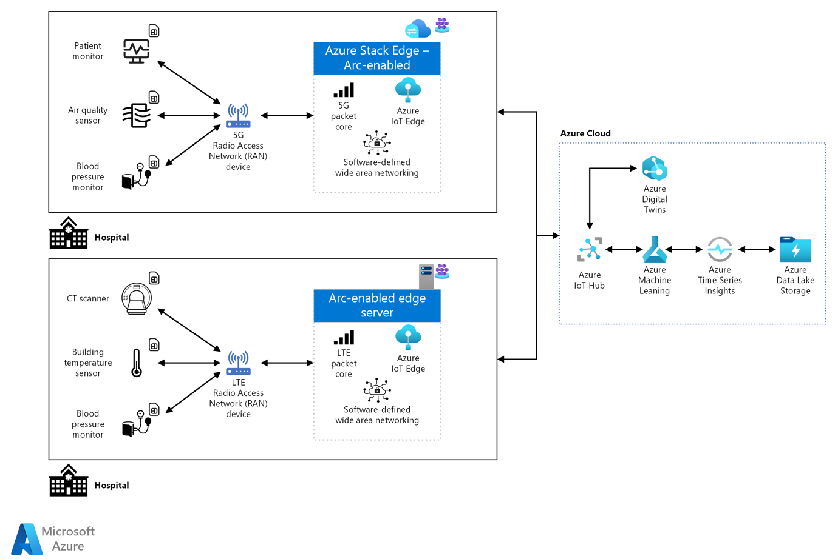
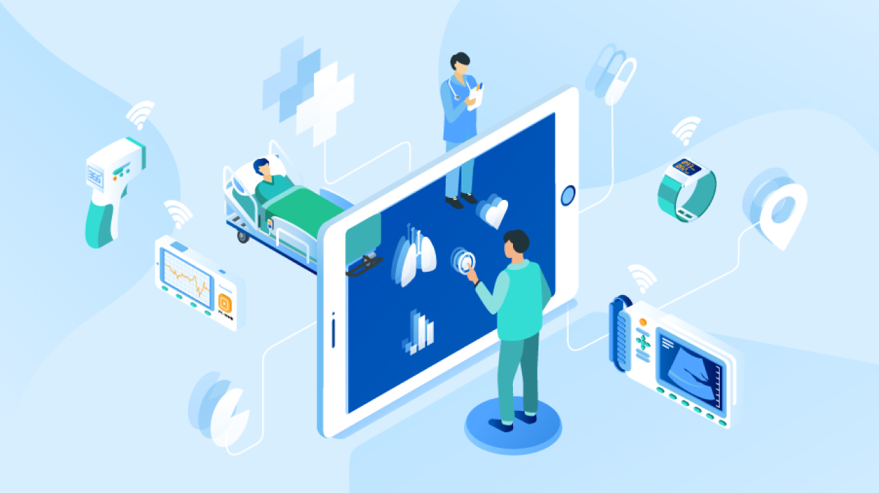
Case studies
IoT Device Connectivity for Healthcare: Hospitals leverage Azure Stack Edge, IoT Hub, and Digital Twins to optimize patient monitoring and facility performance. Applications extend to predictive maintenance and resource management.

Slide 14
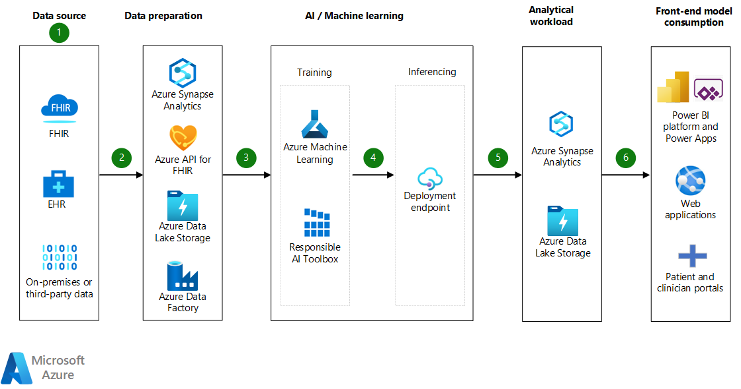
Case studies
Surgical Risk Prediction: Azure Data Factory and API for FHIR enable data integration for machine learning models, predicting surgical risks and improving outcomes.

Slide 16
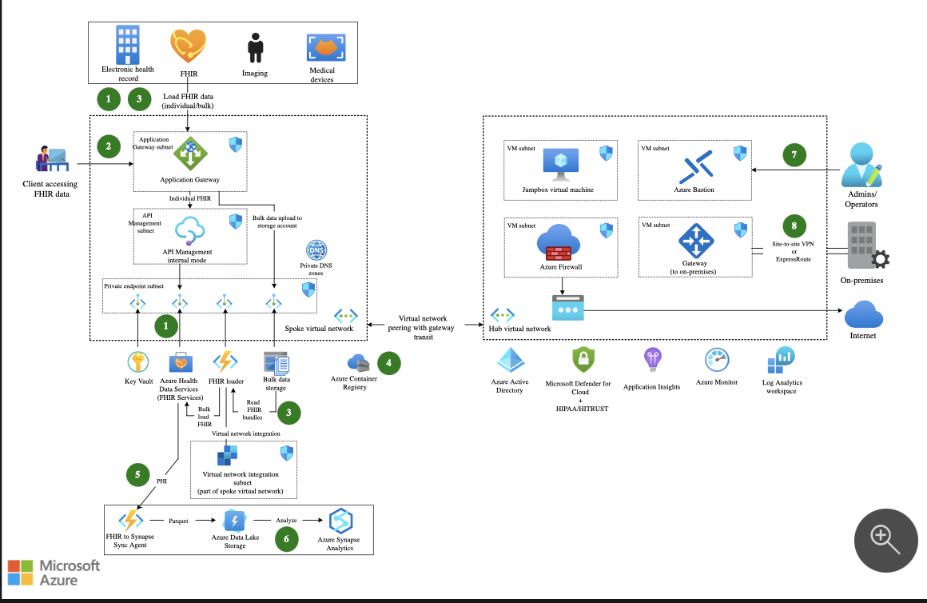
Reference architecture: Azure Health Data Services architecture
https://tinyurl.com/3pdvbty9

Slide 17
Healthcare sector: Reference architecture
Azure Health Data Services architecture
Seamless scalable storage
robust security
powerful data analytics.
1. Azure Health Data Services (FHIR Services)
Implementation: Manages and stores healthcare data using the FHIR standard.
Why It's Critical: Enables secure, standardized sharing of patient data.
Real-World Effect: Hospitals use it to share patient data between departments and external providers efficiently, improving care coordination.
2. API Management (Internal Mode)
Implementation: Acts as a gateway for secure API access and data flow.
Why It's Critical: Ensures secure, authorized access to healthcare data.
Real-World Effect: In hospitals, it controls access to patient records and ensures only authorized users can view or update them.
3. Azure Synapse Analytics
Implementation: Aggregates and analyzes data from various sources for insights.
Why It's Critical: Supports large-scale data processing and analysis.
Real-World Effect: Hospitals use it to analyze trends, predict patient needs, and optimize resource allocation for better care.
https://tinyurl.com/yhfkpef3
https://tinyurl.com/bdhfw6hr
https://tinyurl.com/3k98cp2p

Slide 18

Education and healthcare sectors: Optimisation services and additions
Introduction
Adding advanced services like Azure AI Health Insights, Azure IoT Hub, and others brings cutting-edge capabilities to the existing architecture.
Azure AI Health Insights
Azure IoT Hub
Azure Cognitive Services (Text Analytics for Health)
Azure Machine Learning
Azure Monitor & Healthcare APIs
Key Benefits:
These services enhance patient care with real-time insights, predictive analytics, and seamless IoT integration while ensuring compliance and preparing healthcare systems for future advancements.
https://tinyurl.com/ezhk4v4k
https://tinyurl.com/5ajfj24j
https://tinyurl.com/4fr9xj5v
https://tinyurl.com/vcwnv3df

Slide 19
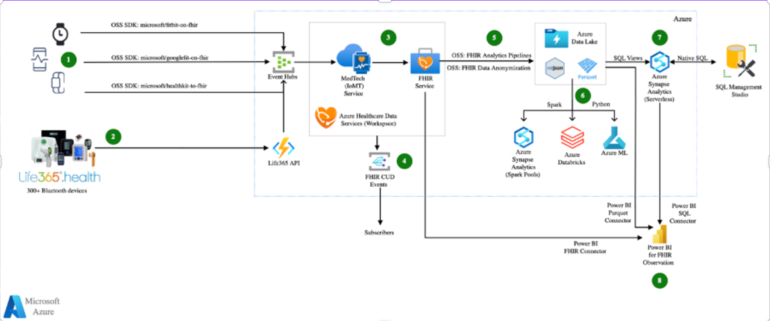
Results, Conclusion and future predictions
Revolutionizing Patient Care and Medical Innovation
Real-time data collection through IoT devices enables continuous monitoring of patient vitals and conditions.
AI-powered analytics drives hyper-personalized treatments and predictive diagnostics, reducing hospital visits and improving patient outcomes.
Seamless Integration of Edge and Cloud Computing
Edge computing delivers low-latency, real-time processing at the source.
Cloud platforms handle extensive data storage and global-scale analytics for enhanced decision-making.
Ensuring Security and Compliance
Technologies comply with regulations like GDPR and MDR, ensuring secure and localized solutions.
Facilitates privacy and accessibility even in regions with stringent data protection laws.
AI-Driven Predictive Models
Helps manage health crises, optimize resource allocation, and forecast disease trends.
Enables proactive healthcare strategies for smarter, greener, and globally inclusive healthcare ecosystems.
https://tinyurl.com/3wpztrd9

Slide 20
Q&A
What role does edge computing serve in healthcare IoT-Cloud solutions?
Data is processed closer to its source by edge computing, which enables low-latency decision-making for important healthcare scenarios, such as real-time monitoring of patient vitals and emergency responses.
Can you explain how compliance with GDPR and HIPAA importantly matters in healthcare cloud solutions? Compliance plays an important role in protecting patient data and guaranteeing privacy.
Compliance is guaranteed in such a way that sensitive patient data is securely as well as ethically handled, thereby protecting privacy while allowing many healthcare providers to adopt revolutionary technologies without legal risks.
How are medical training and education supported by Azure AI tools?
Azure actively supports incredibly engaging training environments by leveraging tools like HoloLens for energetic 3D anatomy visualization and offering AI-driven feedback for importantly adaptive learning, which improves the realism and effectiveness of medical simulations.
How does interoperability play an important role in cloud-based healthcare systems?
Standards like FHIR importantly improve interoperability, allowing for smooth data exchange among many departments and providers, which improves care coordination and decreases redundancies.
What are some impressive real-world applications of IoT-Cloud solutions in healthcare?
Real-time tracking of medical equipment, remote patient monitoring during pandemics, as well as predictive models for surgical risk and patient outcomes are some examples.

Slide 21
Thank you

